Slide 1



EagleSat-1 Project: Mission Synopsis
Deborah Jackson
Embry-Riddle Aeronautical University Aerospace Engineering, Sophomore
AZ/NASA Space Grant Symposium
April 14, 2018

Slide 2

Presentation Overview
Mission Overview
Satellite Structure
Satellite Testing
Integration and Launch
Satellite Communications
Failure Analysis
Next Steps
Future of EagleSat-1

Slide 3
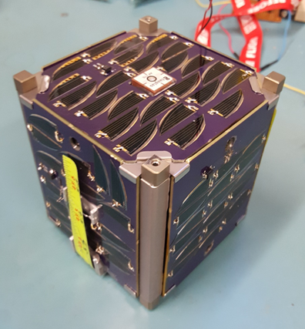
Mission Overview
Primary Objective: Educational
Secondary Objectives:
  Primary: Orbital decay
  Secondary: Supercapacitors
Notes:
Operational goals:
Determine position periodically to approx decay
Store data for transmission
Downlink at request
Beacon identity and telemetry

Slide 4
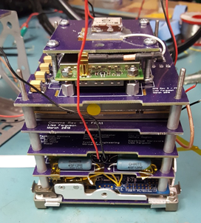
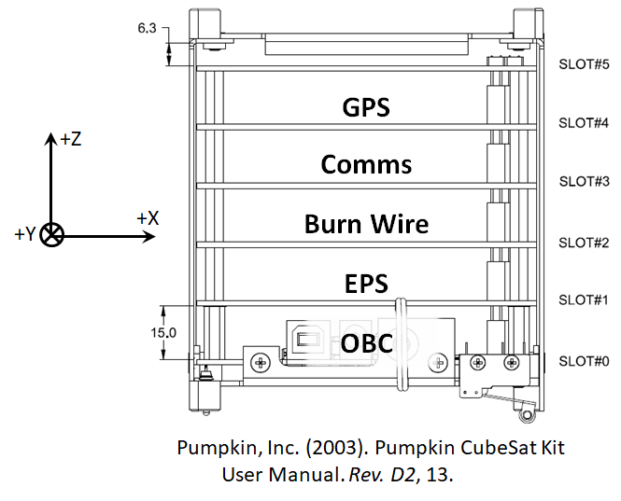
Satellite Structure

Slide 5
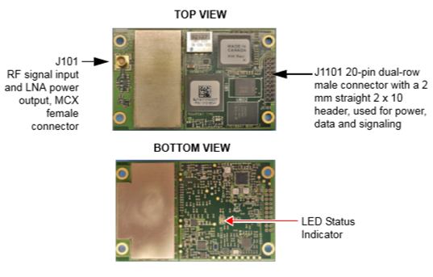
Satellite Structure: GPS
Novatel OEM615

Slide 6
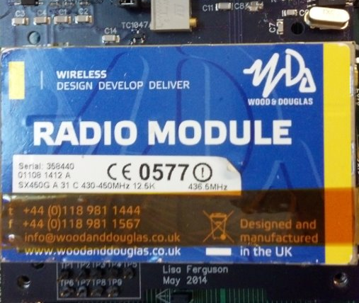
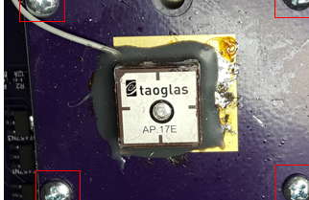
Satellite Structure: Comms
Taoglas Antenna Ceramic GPS Patch for RF
Wood and Douglas Radio Module

Slide 7
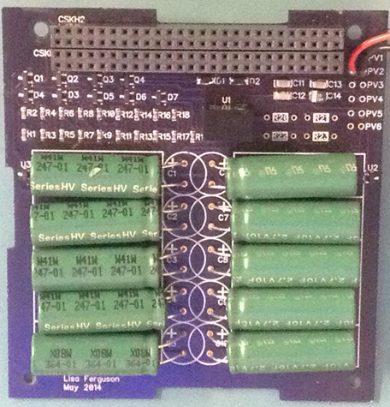
Satellite Structure: Power
Eaton HV1030-2R7106-R 10F (3V) Supercapacitors
Provides 4F (15V)

Slide 8
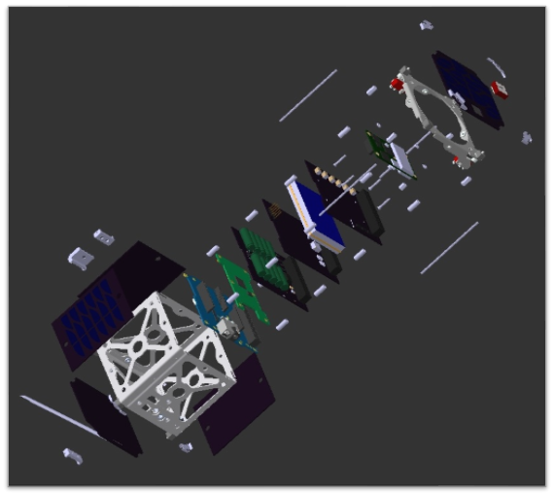
Satellite Structure

Slide 9
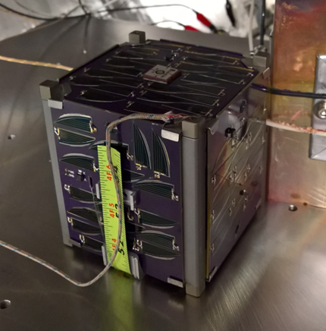
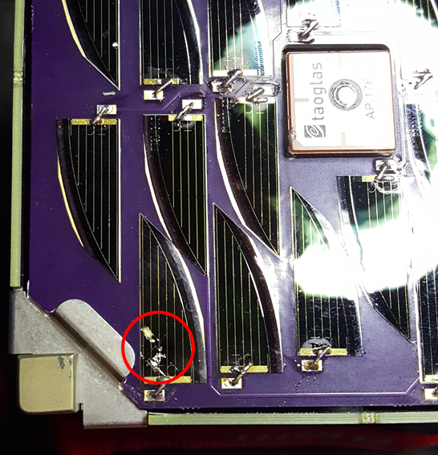
Satellite Testing
Day in the Life Test: software verification
Random Vibration: launch vehicle
Shock: launch vehicle
Thermal Bakeout: outgassing

Slide 10
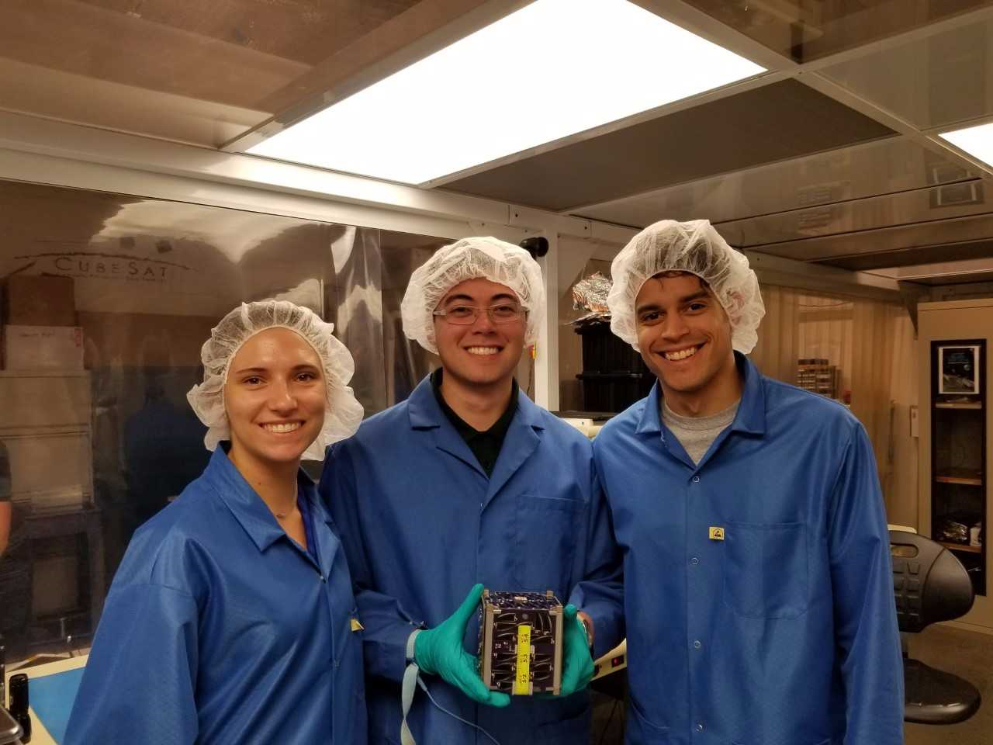
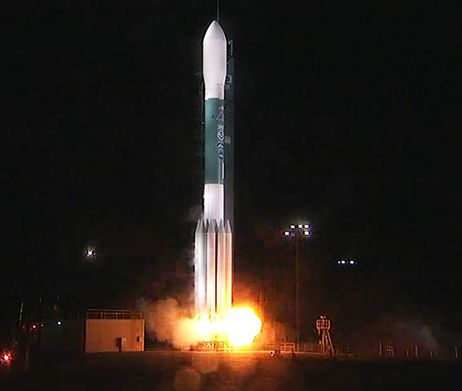
Integration and Launch
NASA (2017)

Slide 11
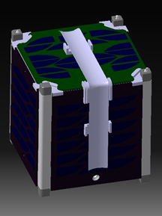
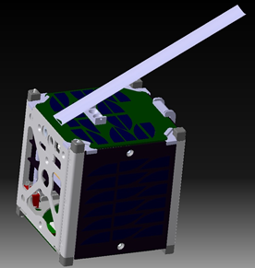
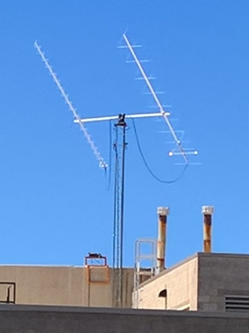
Communications
Notes:
437.645 MHz
monopole, steel, 17.8 cm long, 25 degrees from top of structure
Yagi, 23 elements

Slide 12
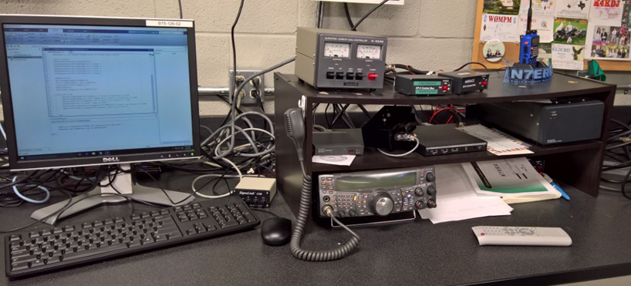
Ground Station
Rotator and Azimuth
Ham Radio Deluxe
TNC
Pre-Amp
Power Supply
Kenwood Radio
Notes:
Azimuth: 450 deg
Elevation: 180 deg

Slide 13
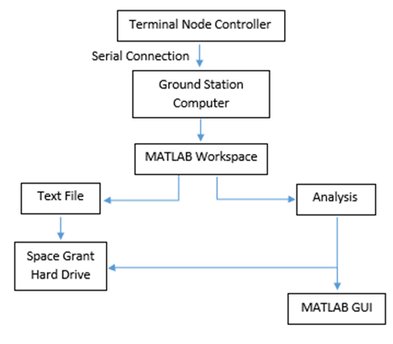
Data Flow

Slide 14
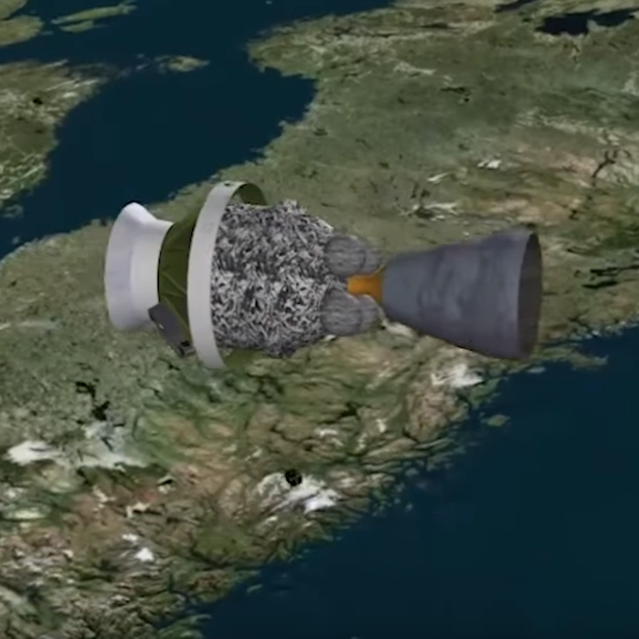
Failure Analysis: Silent Treatment
Antenna not deployed
Discharging before transmitting
  Shorting near solar cells
  GPS consuming
Damaged solar cells
Damaged critical components
United Launch Alliance (2018)

Slide 15
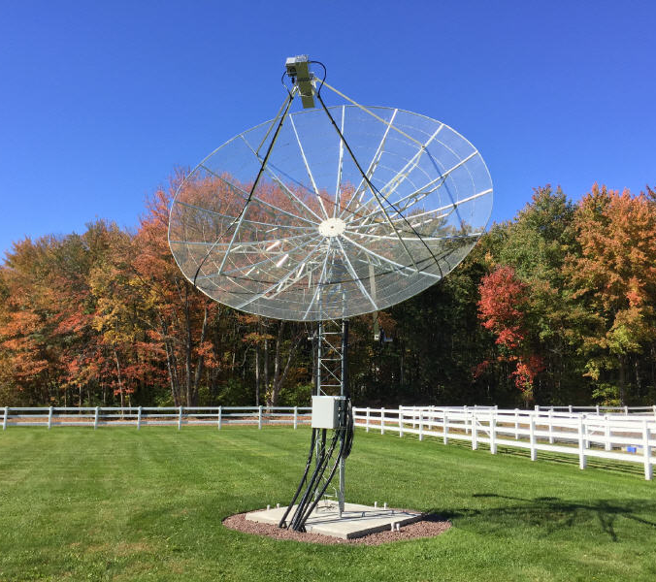
Next Steps
Surrounding frequencies
Old frequency
Eclipsed and non-eclipsed passes
Visual confirmation
4.5 meter dish
Rfhamdesign.com

Slide 16
Future of EagleSat-1
Estimated Life span: 1-2 years
Orbit Life span: 7-9 years
GPS data will analyze models for small satellites
Notes:
Observe, propagate, observe, present discrepancies

Slide 17





Acknowledgements

Slide 18
Questions?
Deborah Jackson jacksd40@my.erau.edu
“Success is not final, failure is not fatal: it is the courage to continue that counts.”
Winston Churchill

Slide 19
Citations
NASA (2017), JPSS Launch 3a [Online Image]. Retrieved March 23, 2018 from https://www.nasa.gov/press-release/nasa-launches-noaa-weather-satellite-aboard-united-launch-alliance-rocket-to-improve.
United Launch Alliance (2017), Delta II JPSS-1 Mission Profile [Screenshot]. Retrieved March 23, 2018 from https://www.youtube.com/watch?v=tLkbdYZyf1c
User picture 4.5 Meter Dish [Online Image]. Retrieved on March 23, 2018 from http://www.rfhamdesign.com/products/parabolicdishkit/45meterdishkit/index.php.

